Slide 1
Automobile insurance system
Project By : Praveen B
Trainer name : Mr. Javeed Mohammed Husnuddin

Slide 2
Tools and technologies used
Backend (Spring Boot) – REST APIs with Hibernate, data validation, JWT security, and logging.
Frontend (ReactJS 19) – Responsive UI with routing, validation, reusable components.
Authentication & Authorization – Secure login, role-based access (Admin/User).
Testing & Tools – Postman for API testing, JUnit for unit tests, Git/GitHub for version control.

Slide 3
Project description
The Automobile Insurance System is a web-based application designed to modernize and digitize the operations of an insurance company.
The system enables customers to register, submit proposals for vehicle insurance, make premium payments, and track policy status, while allowing Admin to review, approve, and manage policy proposals efficiently.
The system leverages modern technologies such as Spring Boot for backend APIs, ReactJS for a responsive frontend, and MySQL for secure data storage.
Key aspects like authentication using JWT, logging, exception handling, ensure that the application is not only user-friendly but also robust and reliable.

Slide 4
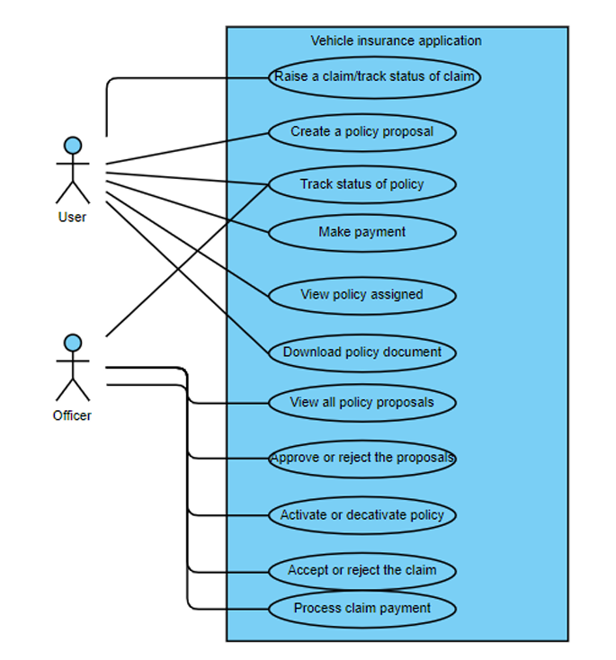
Use case diagram

Slide 5
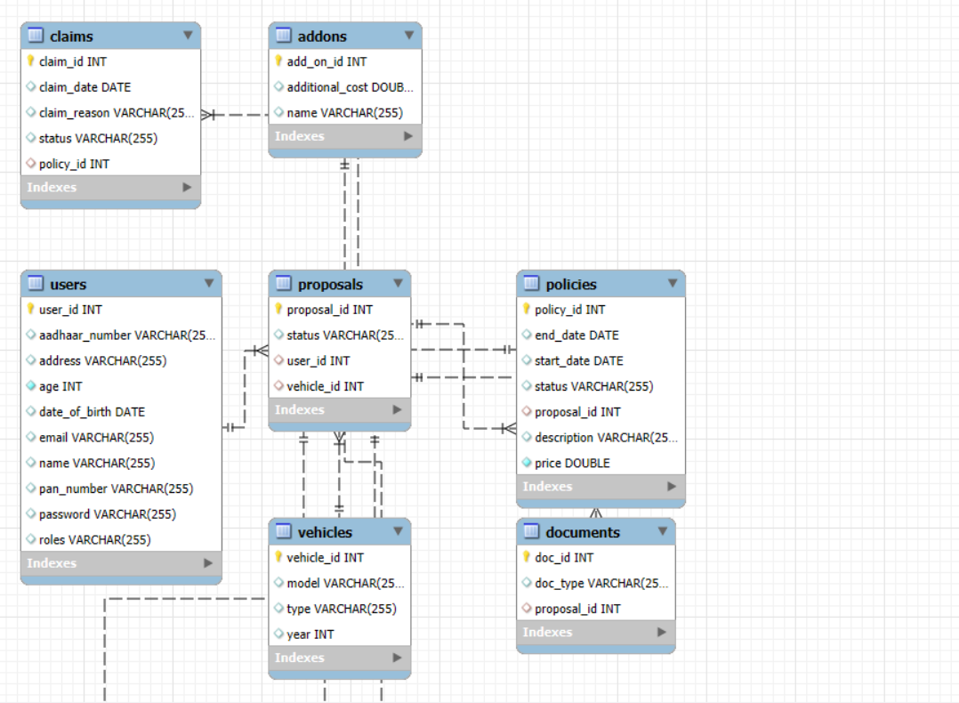
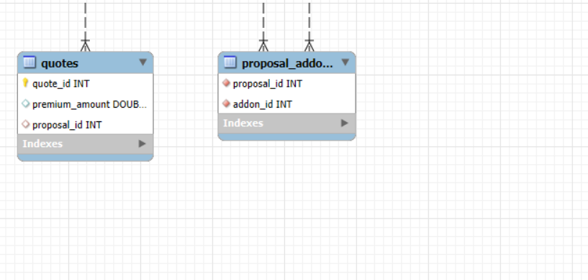
ER diagram

Slide 6
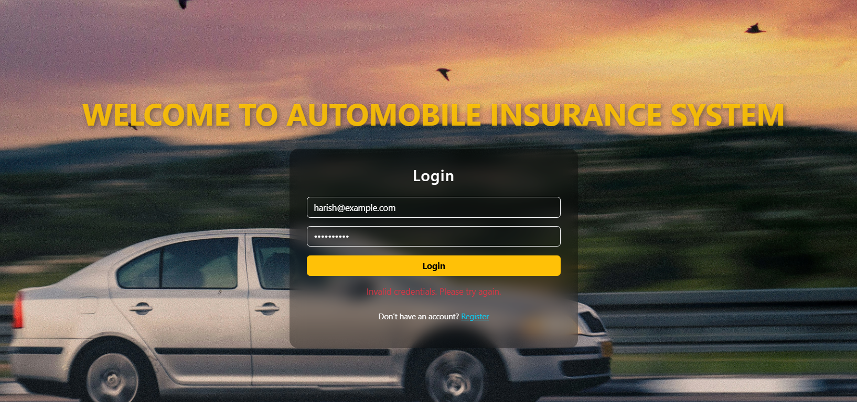
Sample snapshots

Slide 7
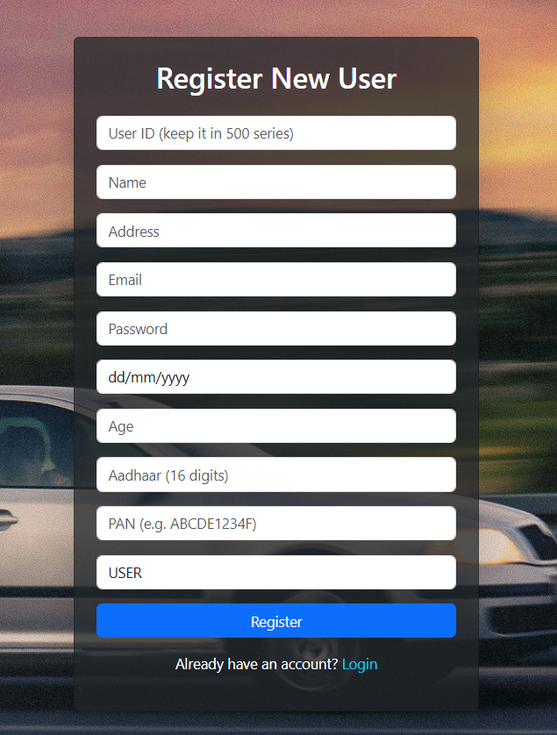
SAMPLE SNAPSHOTS

Slide 8
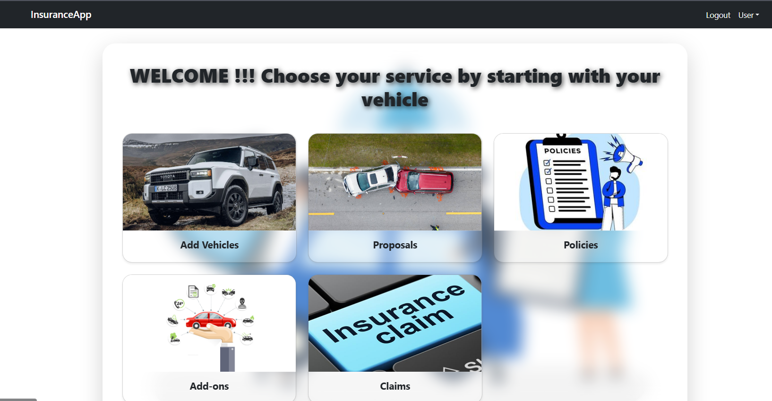
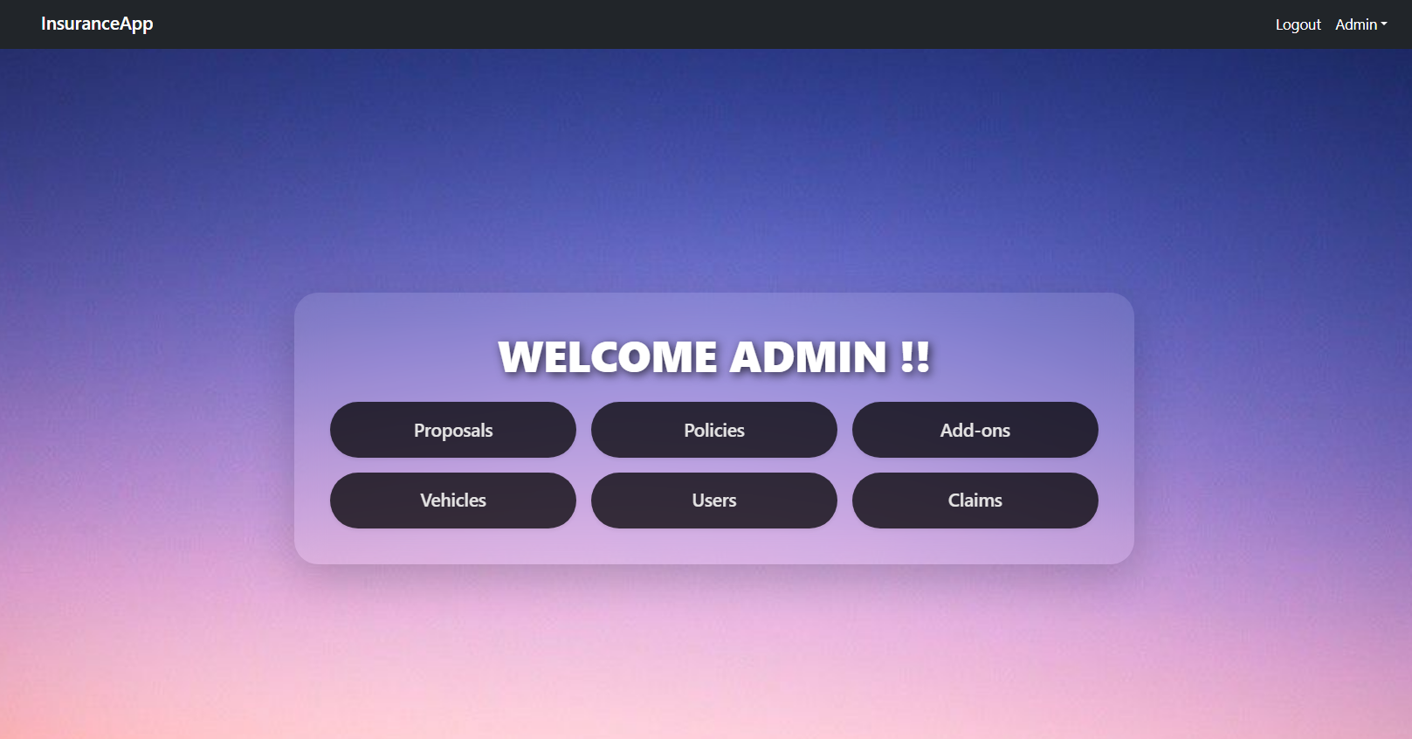
Sample snapshots

Slide 9
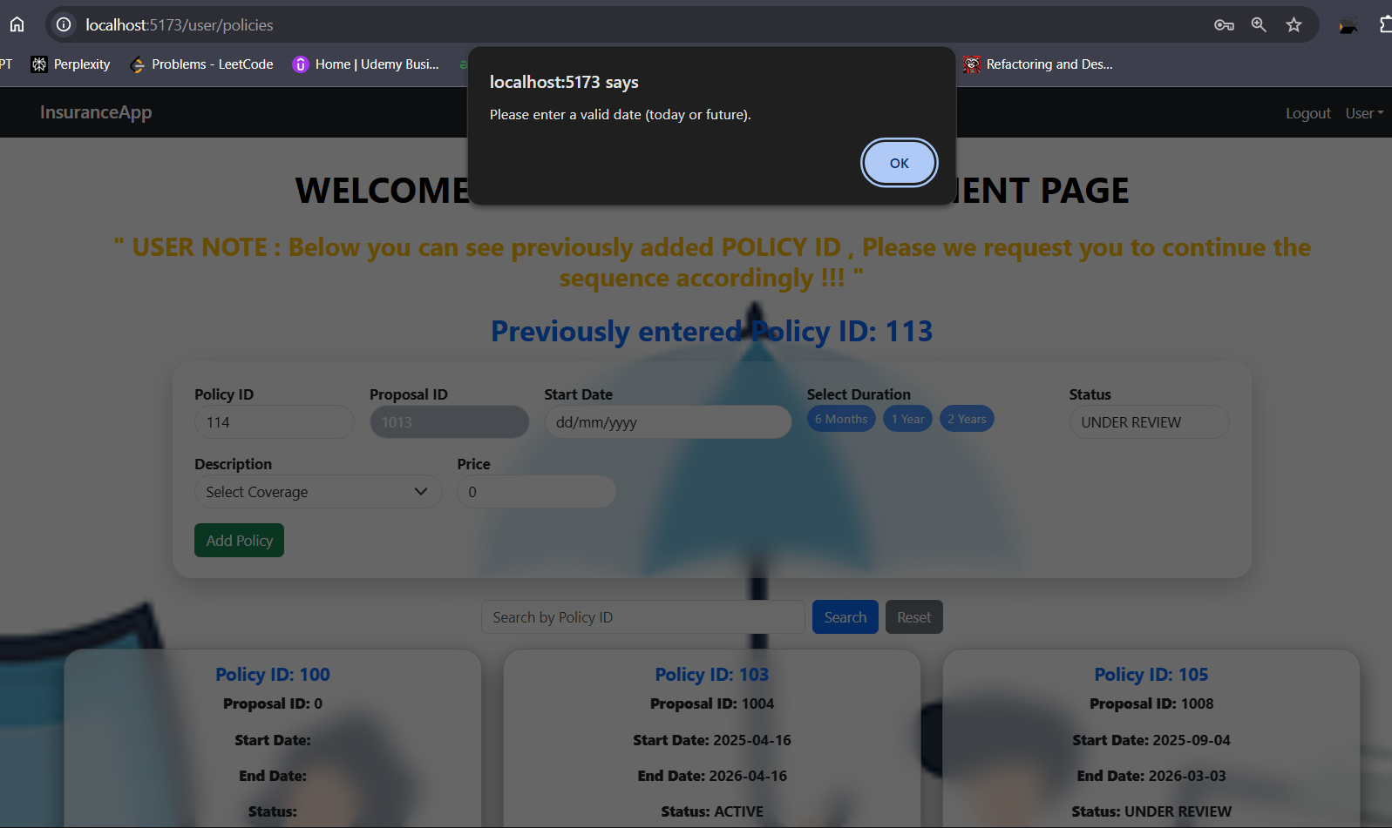
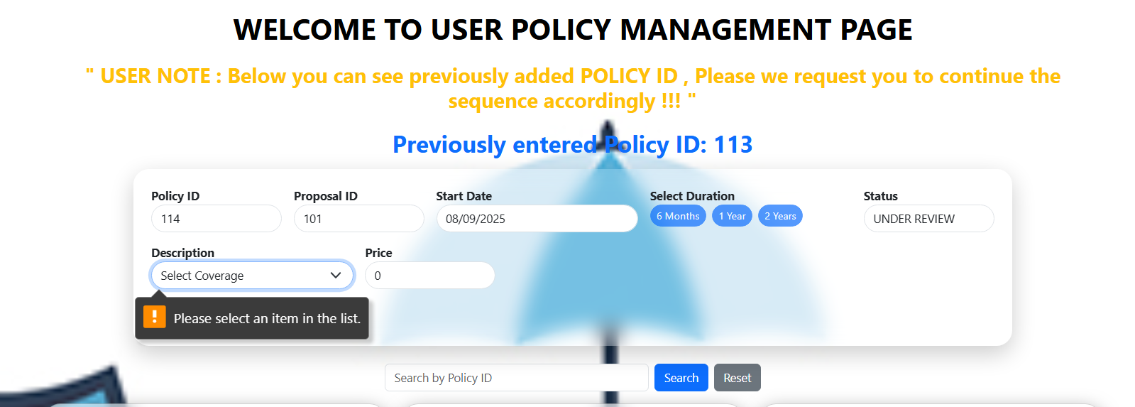
Sample snapshots - validations

Slide 10
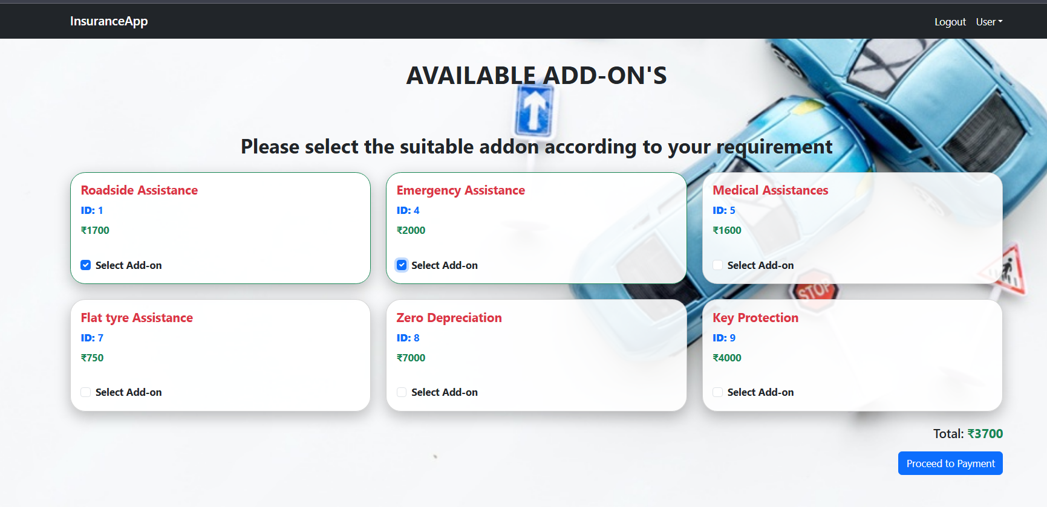
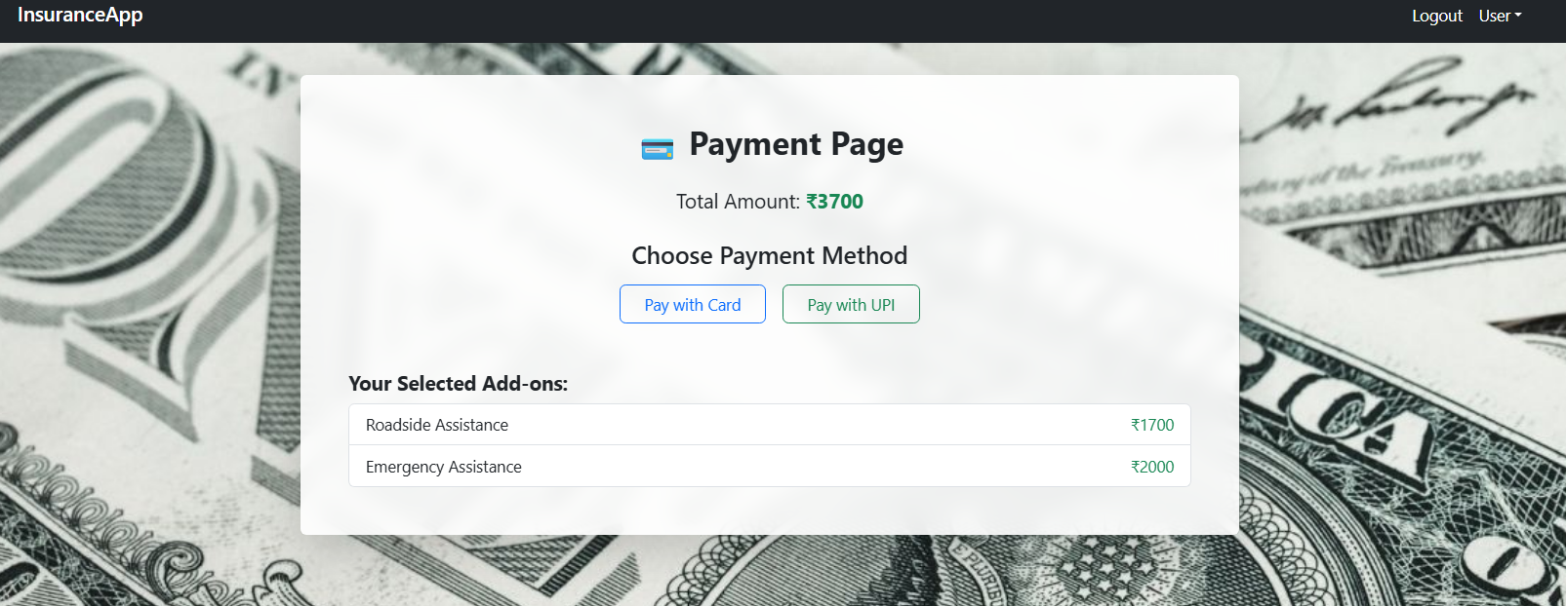

Sample snapshots

Slide 11

THANK YOU

